Slide 1
Assignment #5:
Low-fi Prototype & Test
Team Papaya: Lucy Zhu, Zheng Lian, Xiaohai Liu, Cathy Wang

Slide 2
Introduction

Slide 3
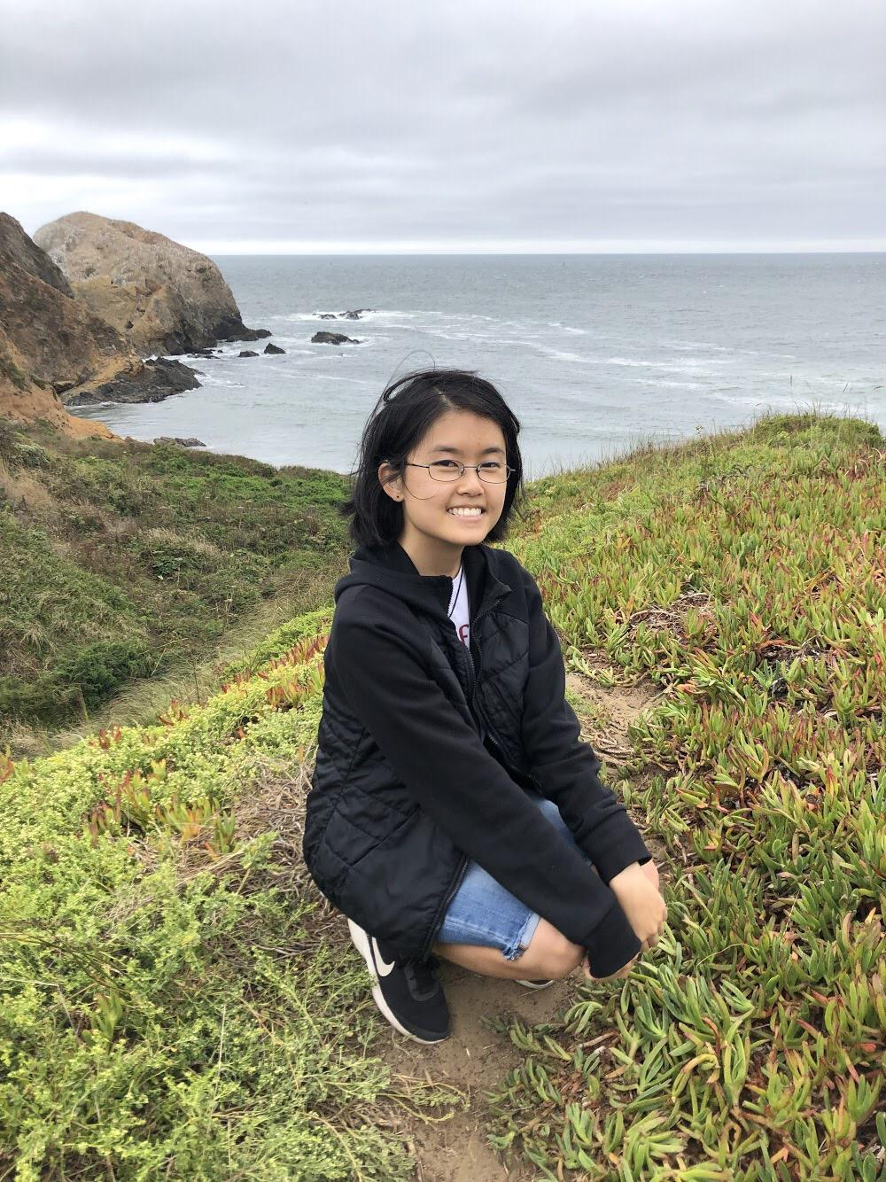
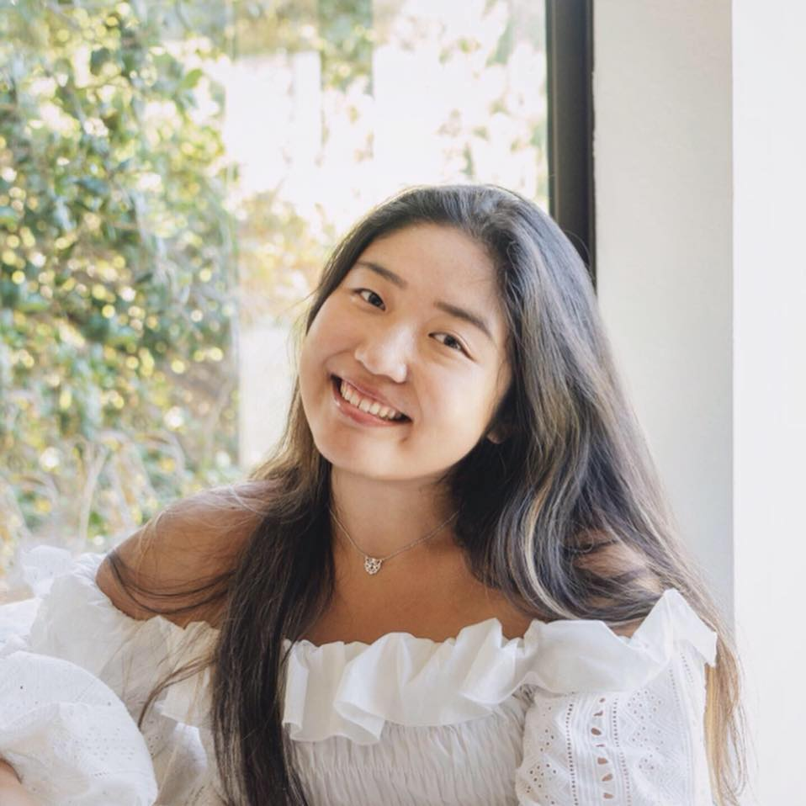
🌟Zheng
🌟Xiaohai
🌟Lucy
🌟Cathy
Team Papaya
Notes:
Our team consists of 4 people: Zheng, Xiaohai, Lucy and Cathy!

Slide 4
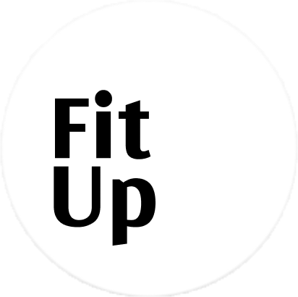
Visualize
And Share
Your First Design
Visualize
And Share
Your First Design

Slide 5
RoadMap
Mission Statement
Selected Interfaces
Low-fi Prototype
Testing and results

Slide 6
Mission Statement
to empower novice fashion designers to build their first stepstone into the fashion industry

Slide 7
Selected Interfaces

Slide 8
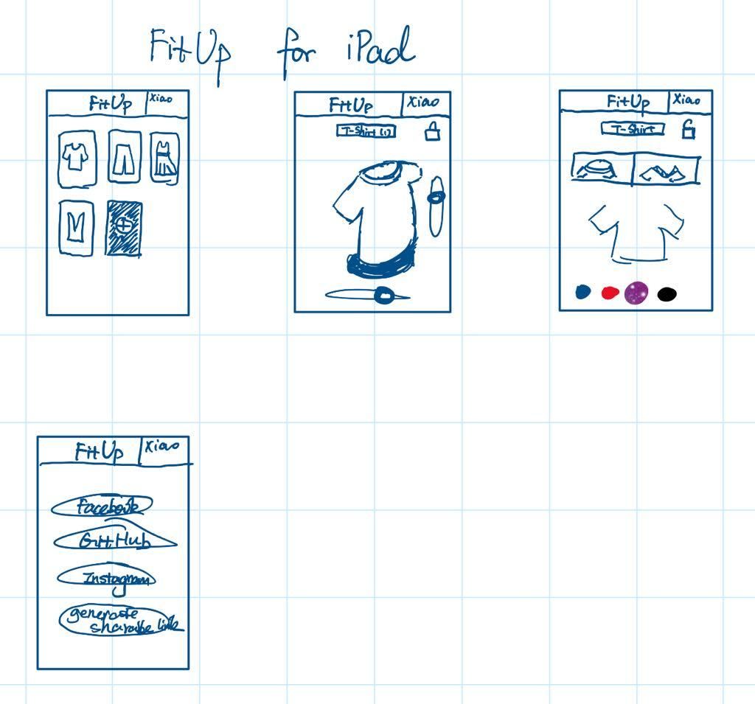
FitUp for iPad FitUp for Apple Watch

Slide 9
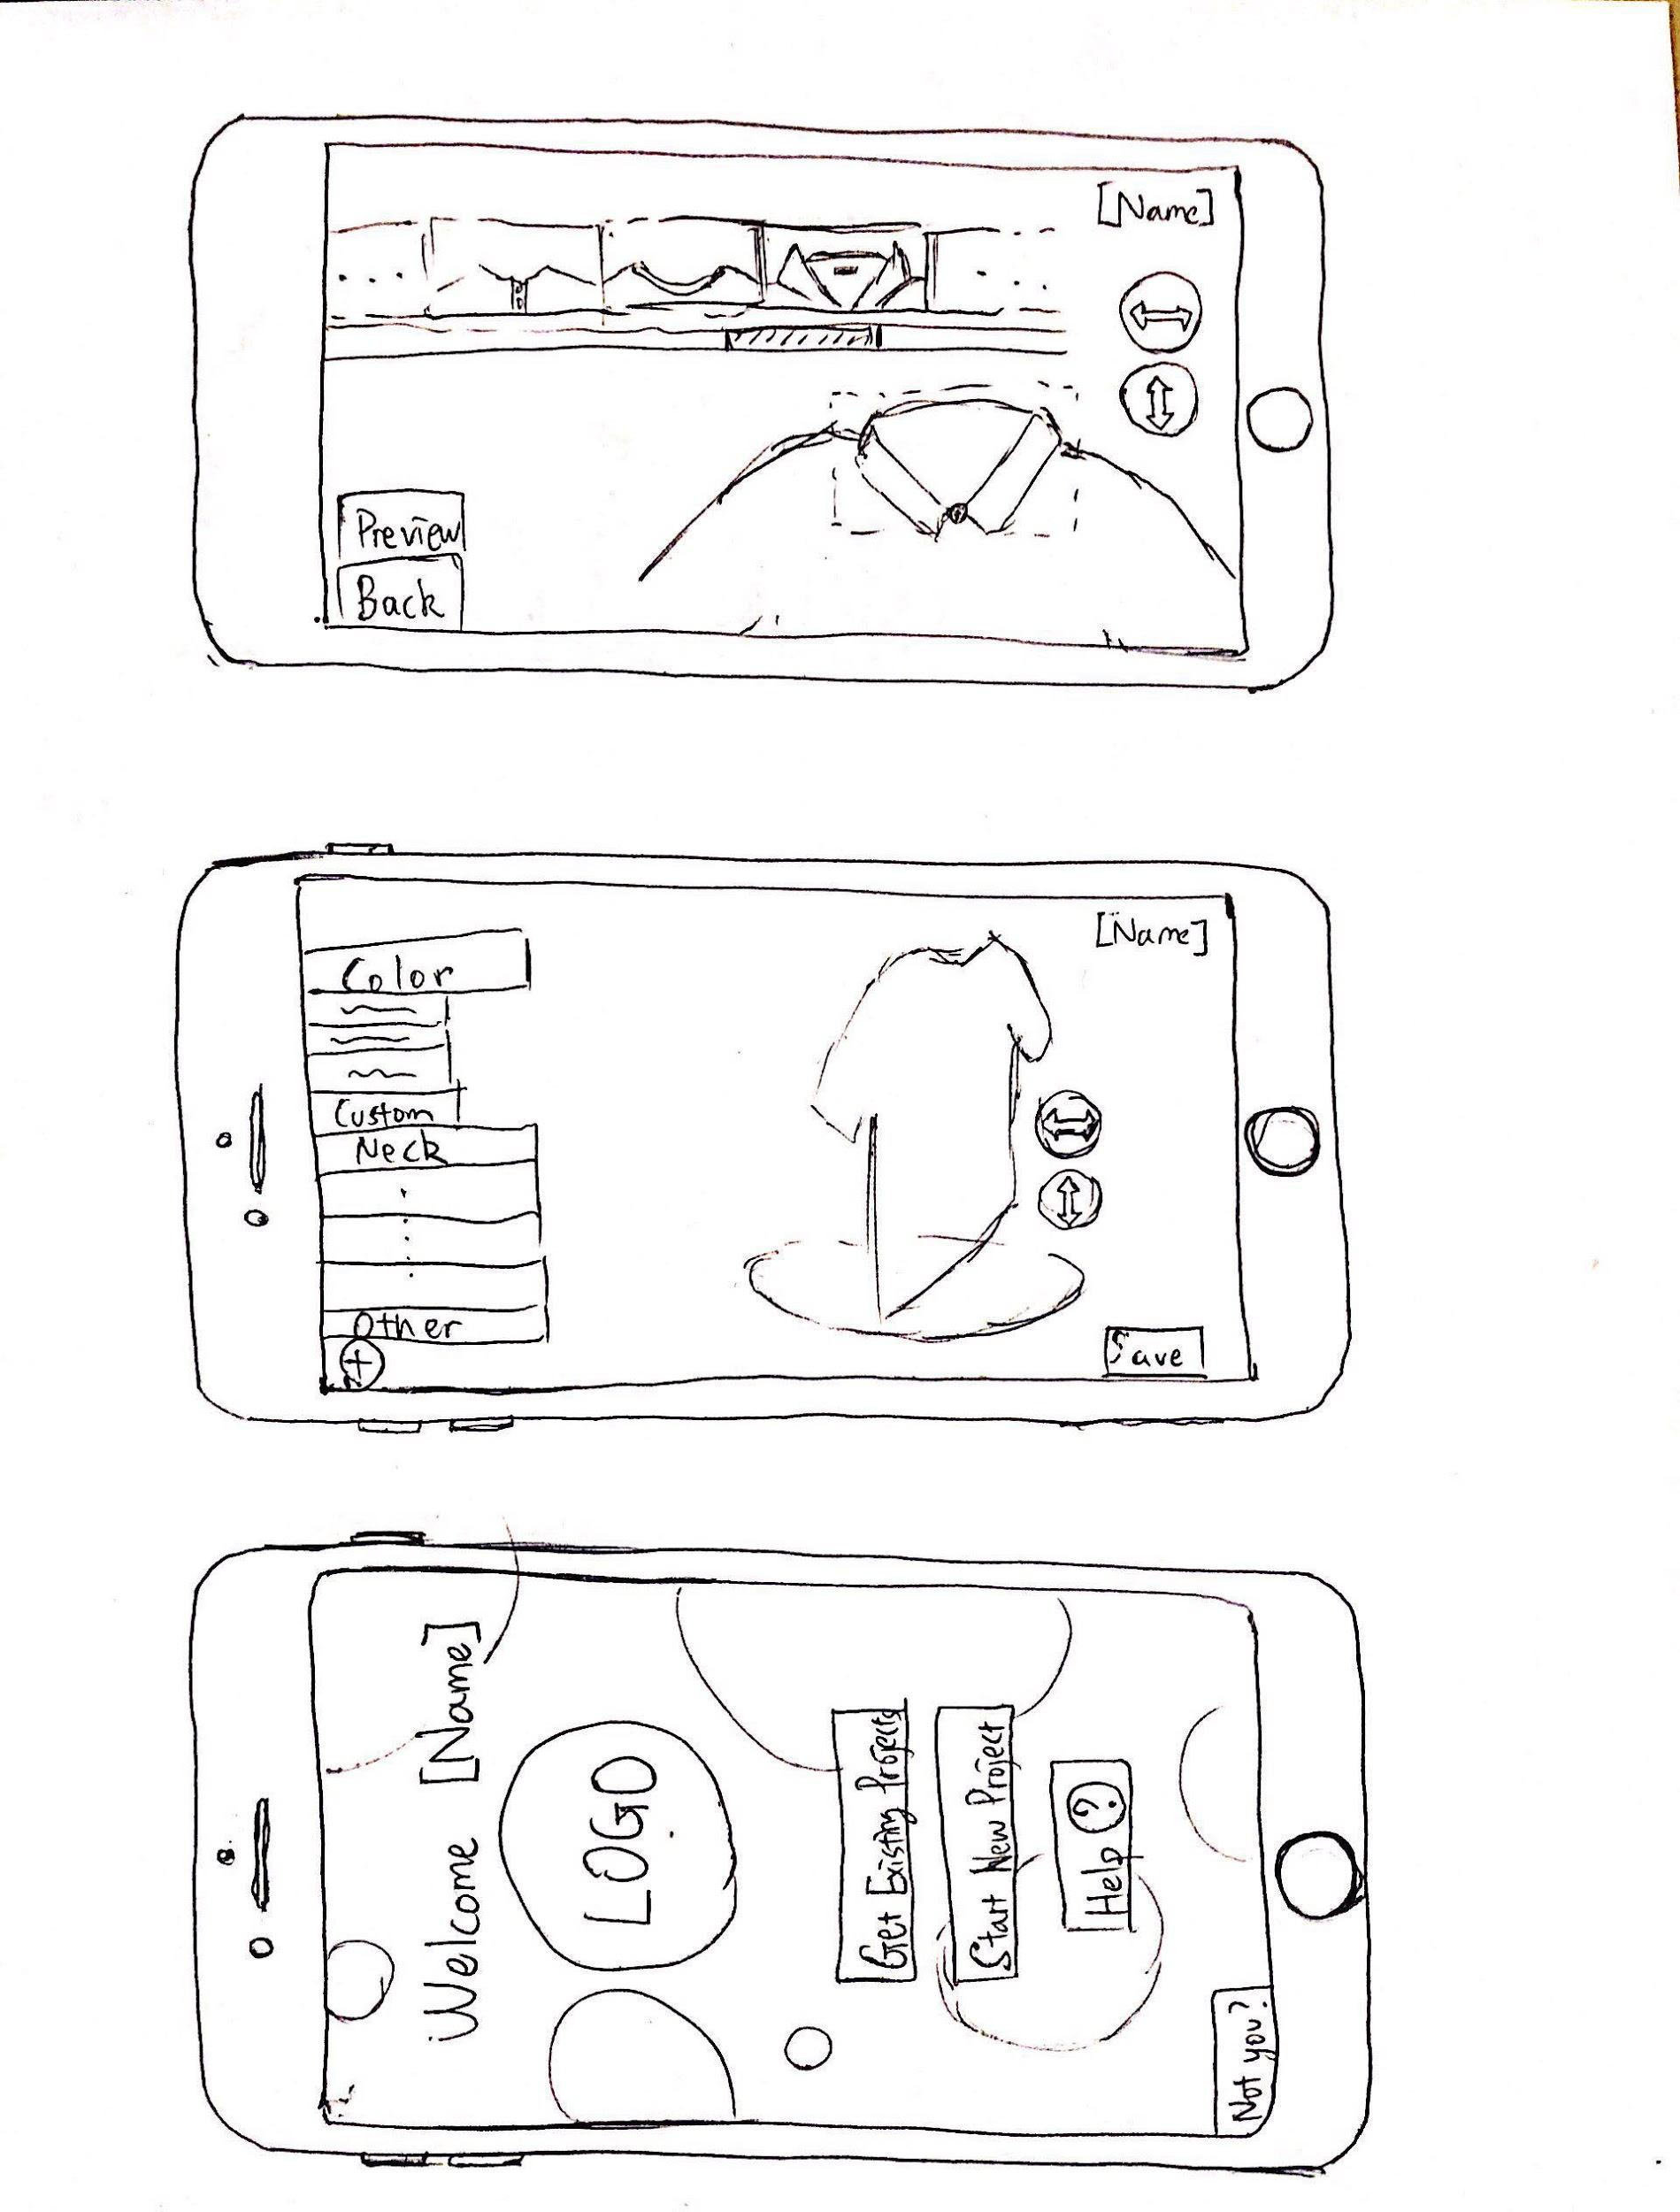
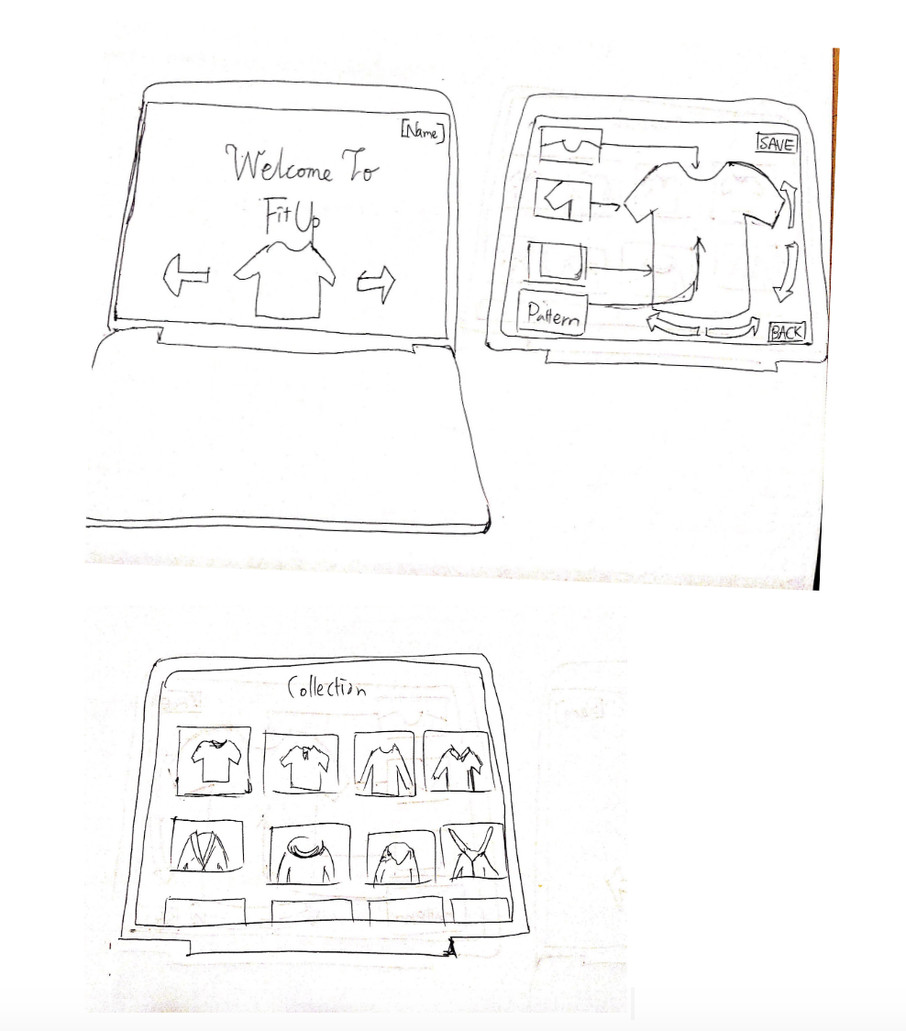
FitUp for Smartphones FitUp for Websites

Slide 10
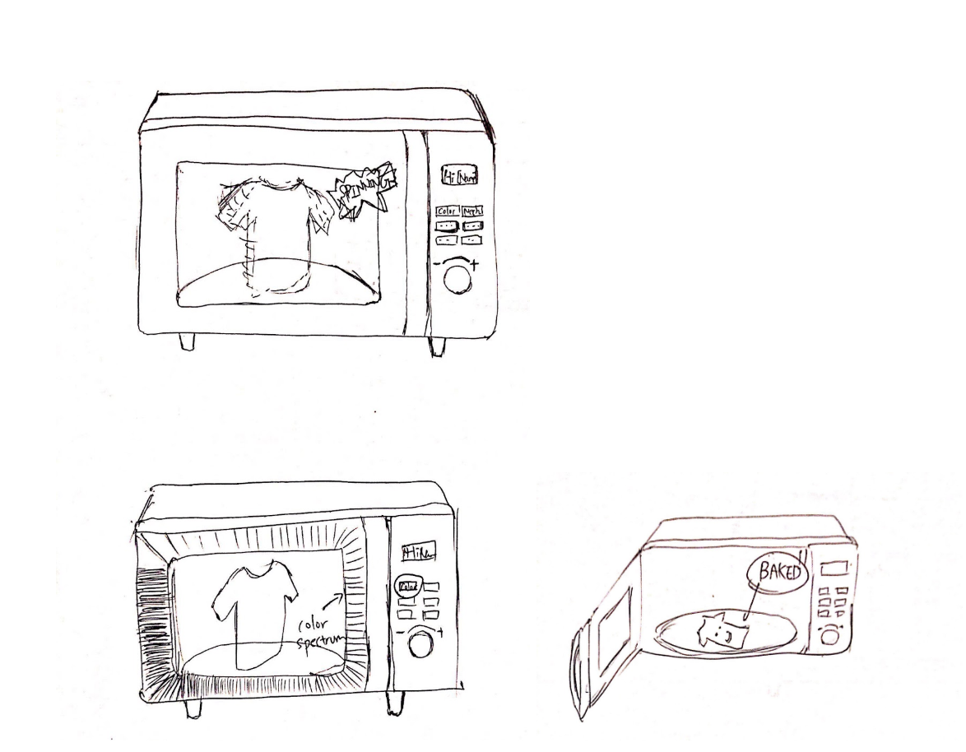
FitUp x Microwave

Slide 11
Low-fi Prototype

Slide 12
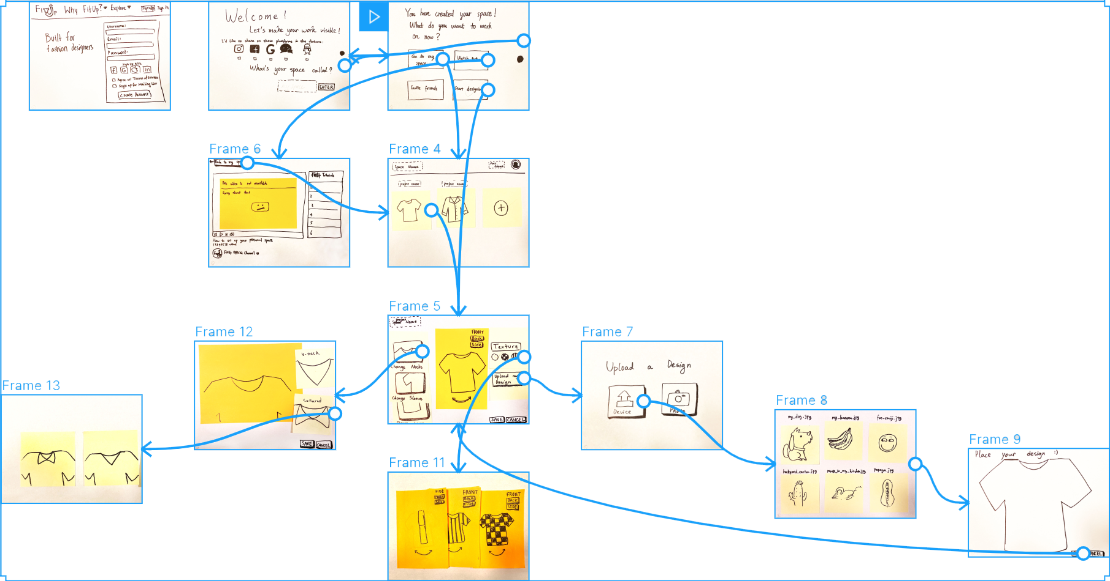

Slide 13
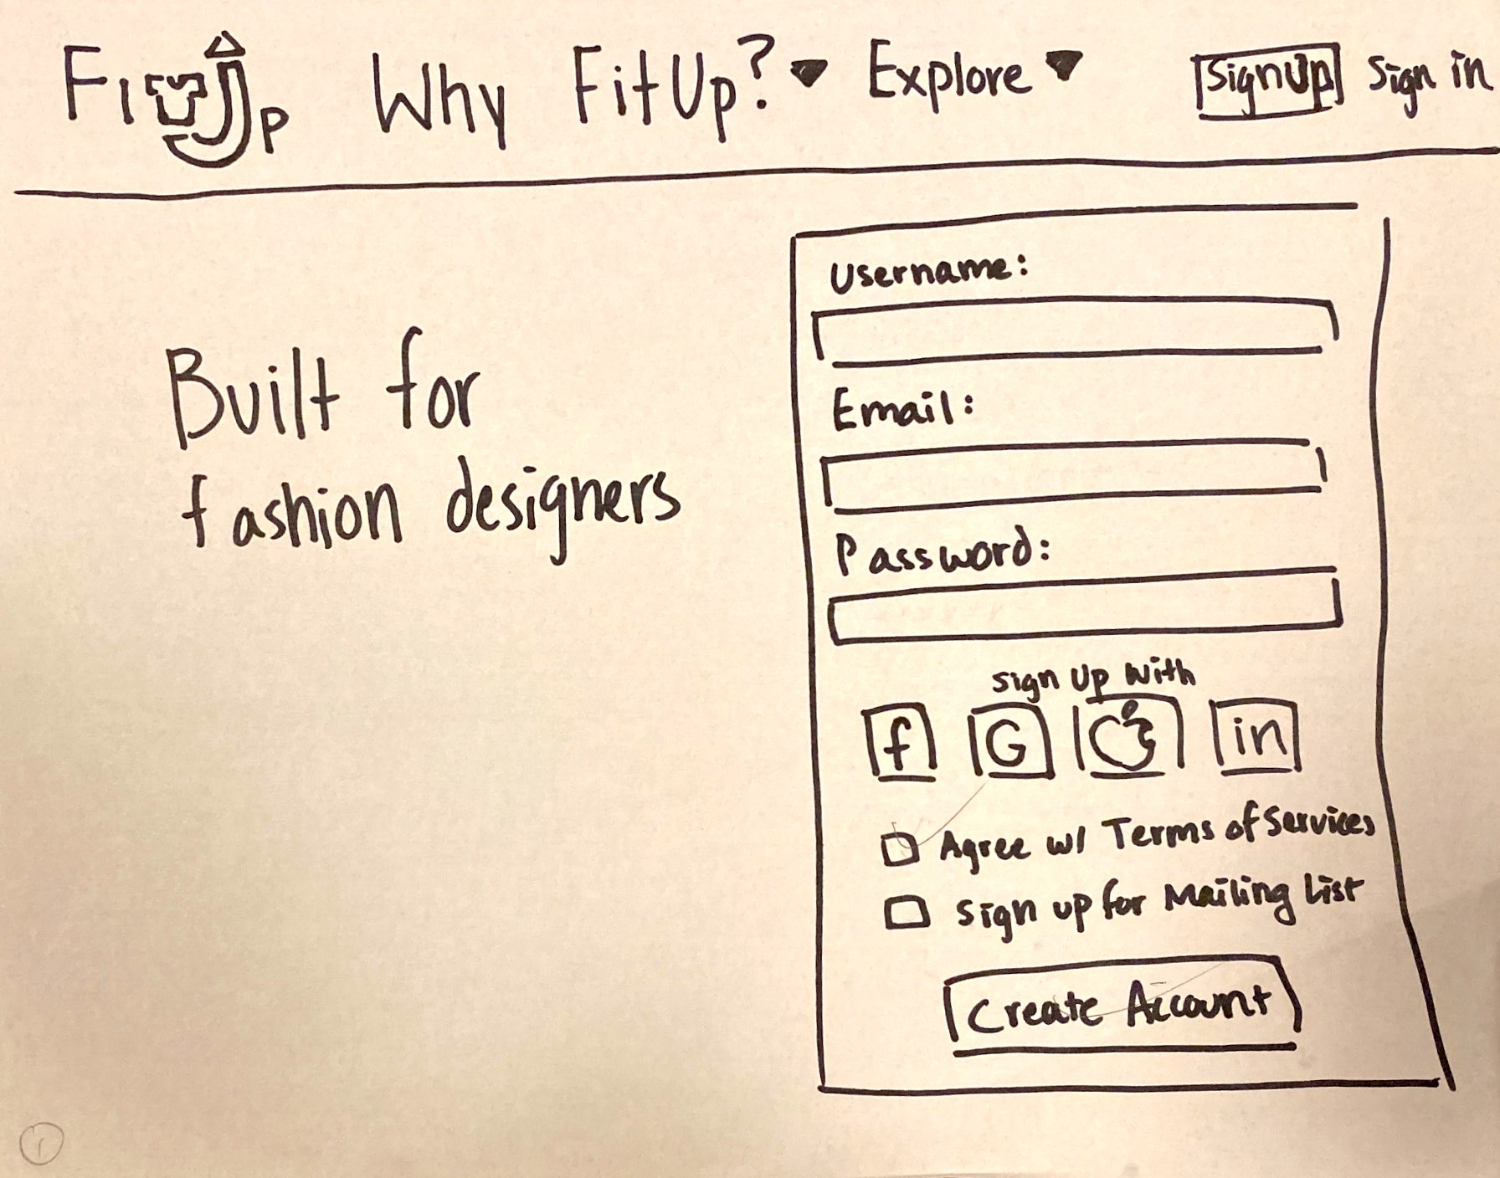

Greetings

Slide 14
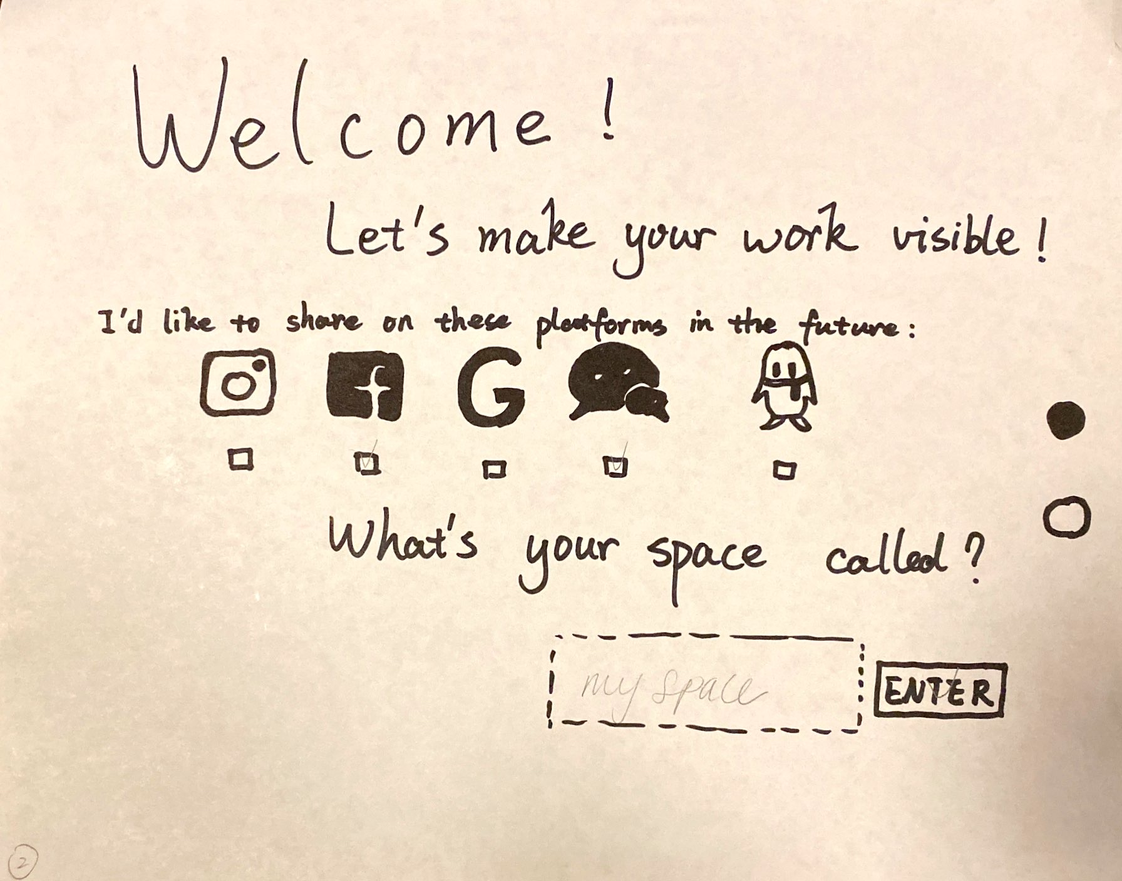
Setup

Slide 15
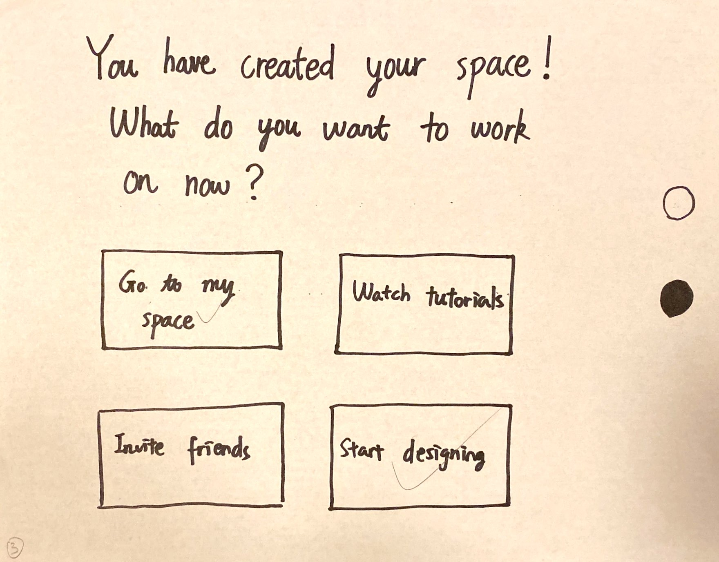
Navigation Options

Slide 16

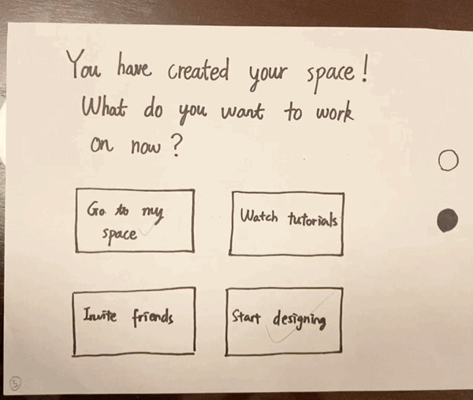
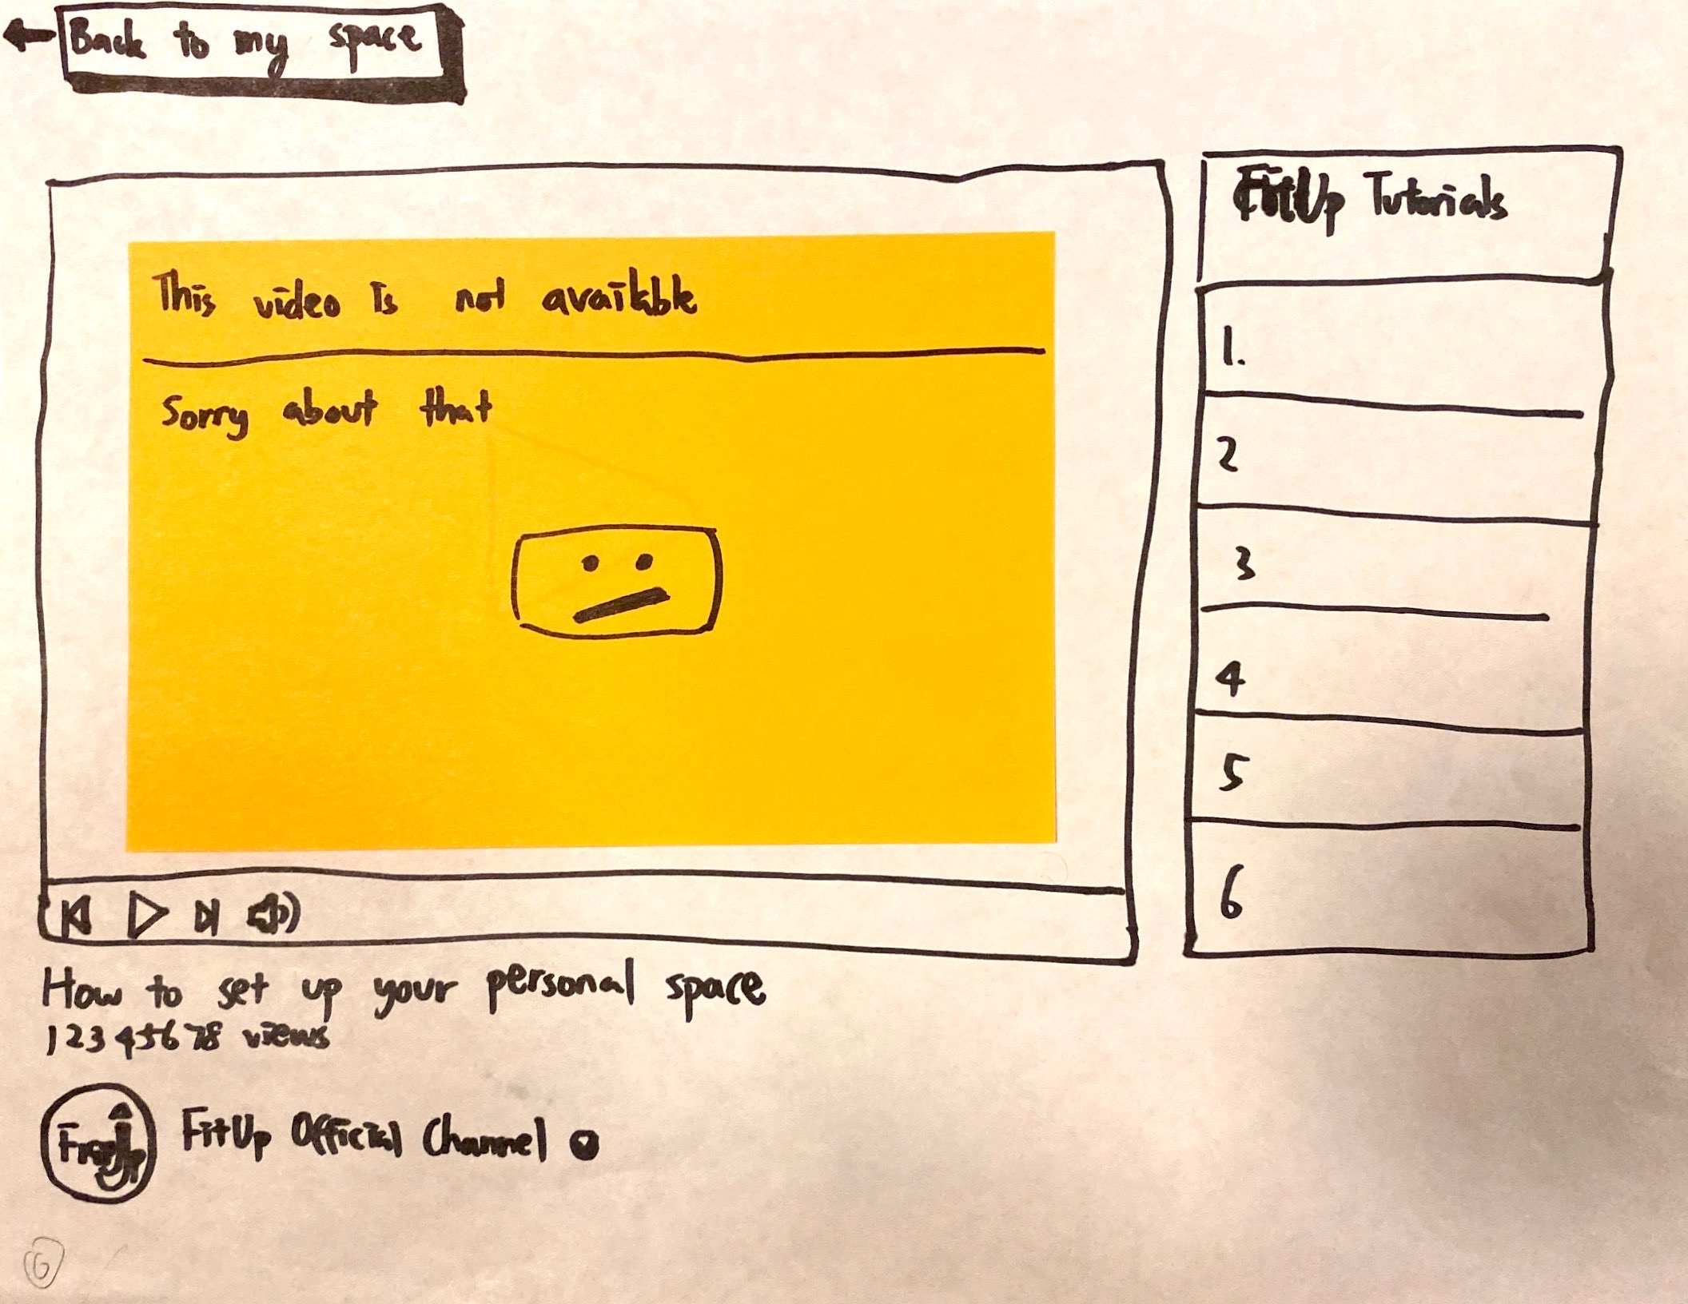
Invite Friends
Watch Tutorials

Slide 17
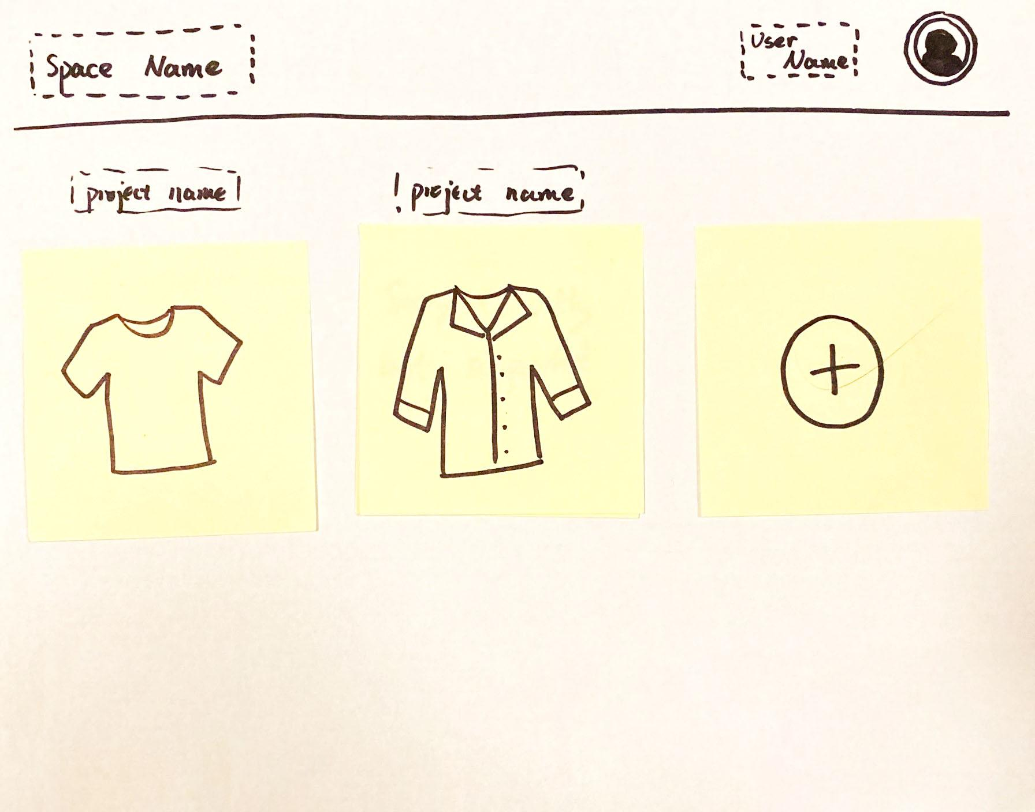
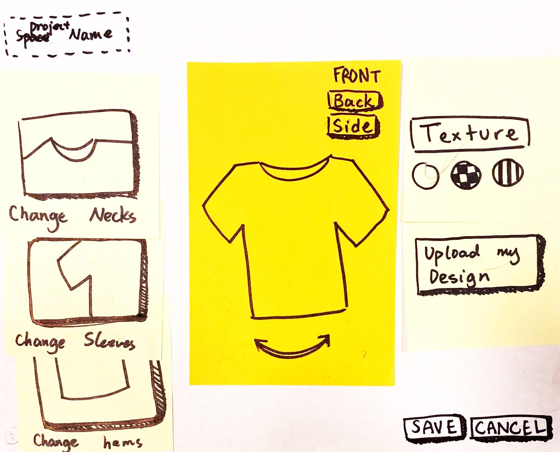
Start Design

Slide 18
Main Design Interface

Slide 19
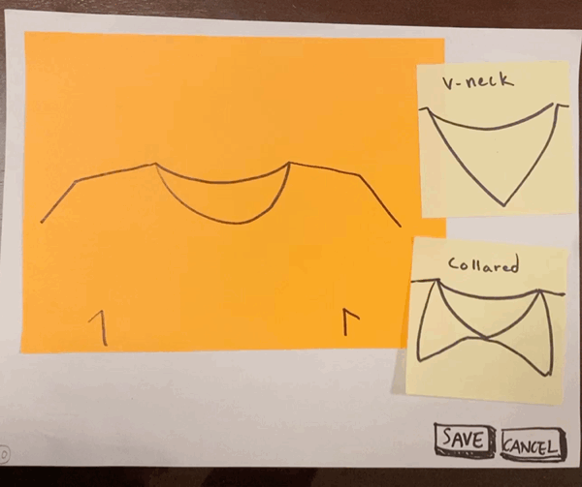
Modify Neckline

Slide 20
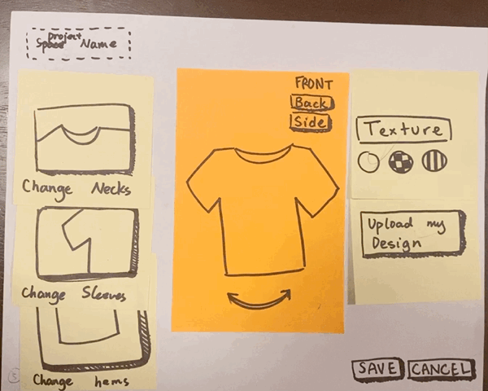
Modify Neckline

Slide 21
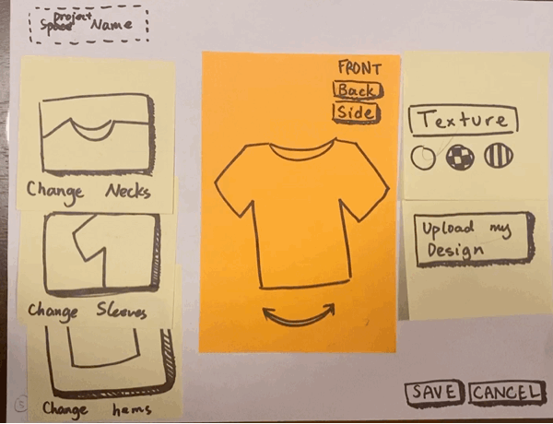
Modify
Texture

Slide 22
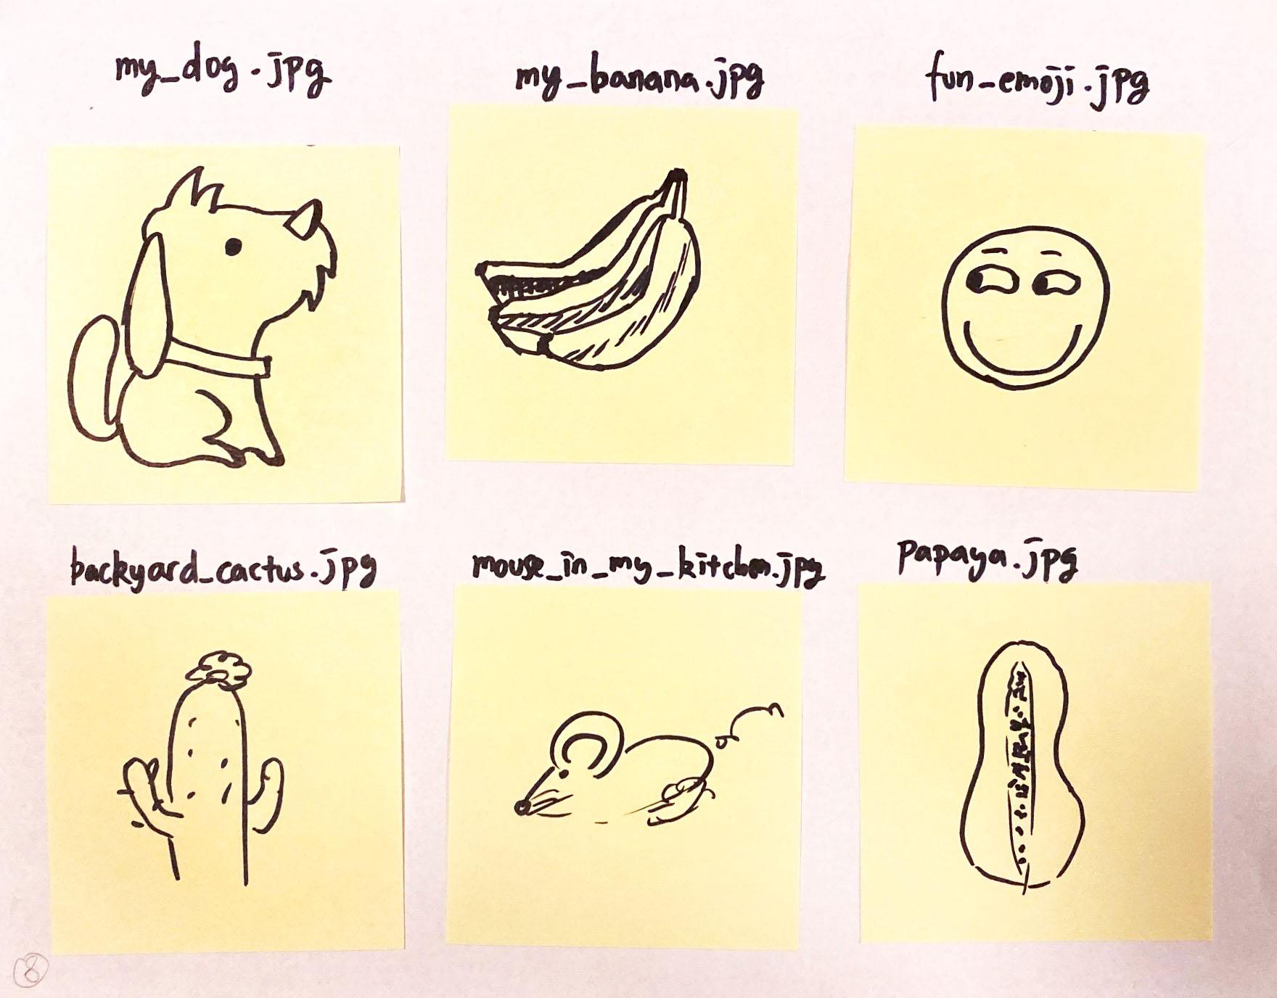
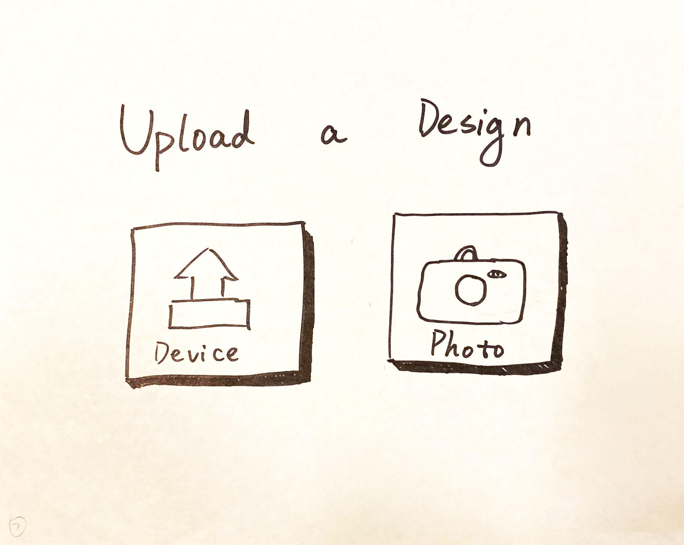
Upload Custom Design

Slide 23
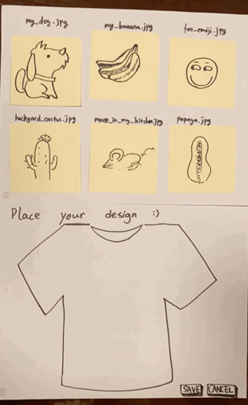
Upload Custom Design

Slide 25
Prototype Testing

Slide 26
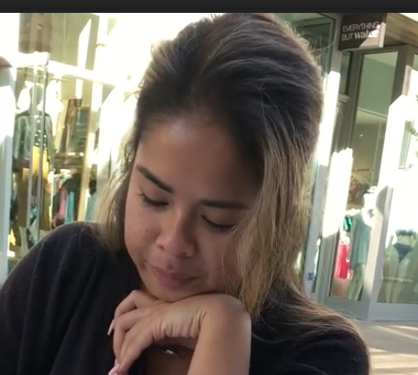
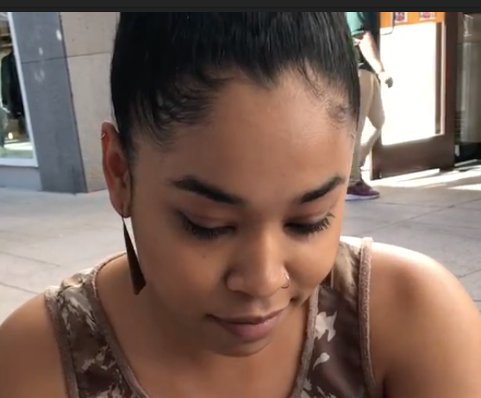
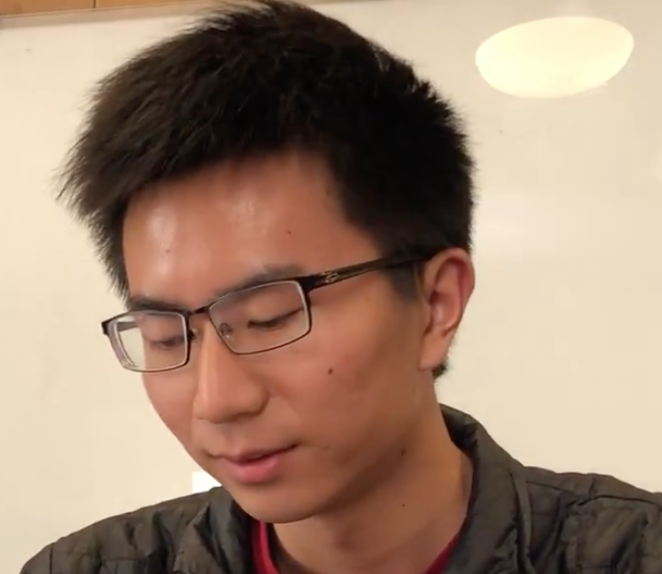
Meet our interviewees
JeniRose
Art and fashion enthusiast
Zannay
Psychometrist
@Stanford hospital
Panda
Math Major
@Stanford

Slide 27
EXPERIMENTAL METHOD
Notes:
We sought people in their 20s or 30s. They are more likely to be acquainted with web applications and are more likely to be following the current fashion trend. We ended up finding two ladies in the Stanford Shopping Center eating lunch. They volunteered with no compensation.
We were also interested to see how students at Stanford would react to our prototype, with their usually good observational skills. We ended up finding a Junior student. No compensation provided.

Slide 28



People in their 20s or 30s
Acquainted with web applications and likely to be following the current fashion trend.
Stanford students with their usually good observational skills

Slide 29
Results

Slide 30
Positive:
All tasks were completed successfully in the end
Buttons and interactable elements easy and intuitive to use, described as “generally makes sense”
Users had fun with the prototype
Notes:
Overall, we learned a lot from testing our prototypes on people we thought would fit in our range of target audience. First, we noticed that even though our interviewees roughly fall into our imagined profile of target audience, individuals tend to have different communication patterns, ways to feel validated/motivated and means to fetch information. We noted that prototype Boost and Tech’s It do not account very well for the personal variation, causing our interviewees feelings of misalignment with the obvious purpose of the prototype. In addition, we acknowledged that some paper prototype(i.e. FitUp), because of its extremely low fidelity, does not realize or indicate the extent of freedom we intend to give users in our imagined final product. Therefore, we need to also reflect on how to grant more freedom and incorporate it most effectively into our low-fi prototype.
In the end, we decided to move on with prototype #3, FitUp, as it seemed to be the most intuitive and generated the result most aligned to our initial assumption. Compared to the other two prototypes, it is also broad enough for us to move on accommodating greater individual differences, because as people tend to, let’s say, follow news and trends differently, the process of creation is largely similar and self-explanatory. In the upcoming weeks, we intend to explore more about how people create and how they can feel comfortable/free/undaunted with fashion design using our interface.

Slide 31
Negative:
Confusion about the function of “Upload your Design” and “Save”.
Notes:
Overall, we learned a lot from testing our prototypes on people we thought would fit in our range of target audience. First, we noticed that even though our interviewees roughly fall into our imagined profile of target audience, individuals tend to have different communication patterns, ways to feel validated/motivated and means to fetch information. We noted that prototype Boost and Tech’s It do not account very well for the personal variation, causing our interviewees feelings of misalignment with the obvious purpose of the prototype. In addition, we acknowledged that some paper prototype(i.e. FitUp), because of its extremely low fidelity, does not realize or indicate the extent of freedom we intend to give users in our imagined final product. Therefore, we need to also reflect on how to grant more freedom and incorporate it most effectively into our low-fi prototype.
In the end, we decided to move on with prototype #3, FitUp, as it seemed to be the most intuitive and generated the result most aligned to our initial assumption. Compared to the other two prototypes, it is also broad enough for us to move on accommodating greater individual differences, because as people tend to, let’s say, follow news and trends differently, the process of creation is largely similar and self-explanatory. In the upcoming weeks, we intend to explore more about how people create and how they can feel comfortable/free/undaunted with fashion design using our interface.

Slide 32
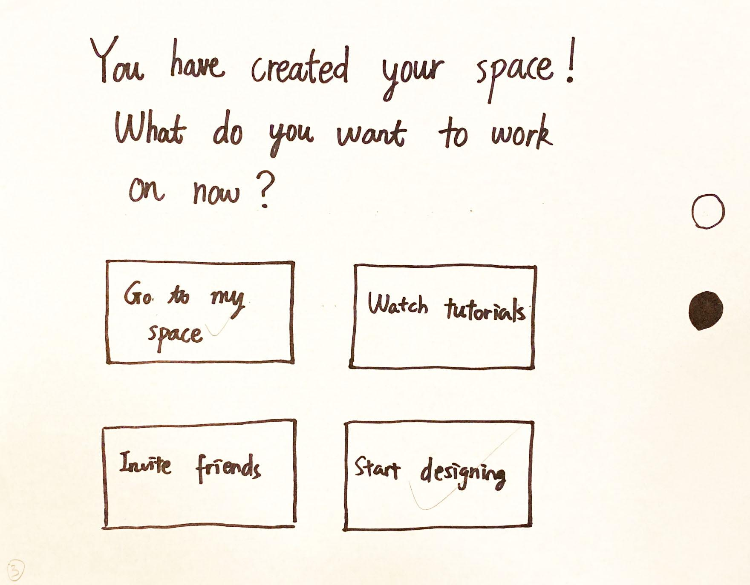
Negative:
The concept of “My Space” was confusing
Notes:
Overall, we learned a lot from testing our prototypes on people we thought would fit in our range of target audience. First, we noticed that even though our interviewees roughly fall into our imagined profile of target audience, individuals tend to have different communication patterns, ways to feel validated/motivated and means to fetch information. We noted that prototype Boost and Tech’s It do not account very well for the personal variation, causing our interviewees feelings of misalignment with the obvious purpose of the prototype. In addition, we acknowledged that some paper prototype(i.e. FitUp), because of its extremely low fidelity, does not realize or indicate the extent of freedom we intend to give users in our imagined final product. Therefore, we need to also reflect on how to grant more freedom and incorporate it most effectively into our low-fi prototype.
In the end, we decided to move on with prototype #3, FitUp, as it seemed to be the most intuitive and generated the result most aligned to our initial assumption. Compared to the other two prototypes, it is also broad enough for us to move on accommodating greater individual differences, because as people tend to, let’s say, follow news and trends differently, the process of creation is largely similar and self-explanatory. In the upcoming weeks, we intend to explore more about how people create and how they can feel comfortable/free/undaunted with fashion design using our interface.

Slide 33
Negative:
Without much functionality, prototype feels like a game instead of a professional tool
Notes:
Overall, we learned a lot from testing our prototypes on people we thought would fit in our range of target audience. First, we noticed that even though our interviewees roughly fall into our imagined profile of target audience, individuals tend to have different communication patterns, ways to feel validated/motivated and means to fetch information. We noted that prototype Boost and Tech’s It do not account very well for the personal variation, causing our interviewees feelings of misalignment with the obvious purpose of the prototype. In addition, we acknowledged that some paper prototype(i.e. FitUp), because of its extremely low fidelity, does not realize or indicate the extent of freedom we intend to give users in our imagined final product. Therefore, we need to also reflect on how to grant more freedom and incorporate it most effectively into our low-fi prototype.
In the end, we decided to move on with prototype #3, FitUp, as it seemed to be the most intuitive and generated the result most aligned to our initial assumption. Compared to the other two prototypes, it is also broad enough for us to move on accommodating greater individual differences, because as people tend to, let’s say, follow news and trends differently, the process of creation is largely similar and self-explanatory. In the upcoming weeks, we intend to explore more about how people create and how they can feel comfortable/free/undaunted with fashion design using our interface.

Slide 34
Future Iterations

Slide 35
Introduce the product’s uses more explicitly in the landing page
More clearly defined terms/tutorials telling the customers what words refer to what
Add more customizability to the product so that it feels more professional
Add sharing functions more explicitly
Notes:
Overall, we learned a lot from testing our prototypes on people we thought would fit in our range of target audience. First, we noticed that even though our interviewees roughly fall into our imagined profile of target audience, individuals tend to have different communication patterns, ways to feel validated/motivated and means to fetch information. We noted that prototype Boost and Tech’s It do not account very well for the personal variation, causing our interviewees feelings of misalignment with the obvious purpose of the prototype. In addition, we acknowledged that some paper prototype(i.e. FitUp), because of its extremely low fidelity, does not realize or indicate the extent of freedom we intend to give users in our imagined final product. Therefore, we need to also reflect on how to grant more freedom and incorporate it most effectively into our low-fi prototype.
In the end, we decided to move on with prototype #3, FitUp, as it seemed to be the most intuitive and generated the result most aligned to our initial assumption. Compared to the other two prototypes, it is also broad enough for us to move on accommodating greater individual differences, because as people tend to, let’s say, follow news and trends differently, the process of creation is largely similar and self-explanatory. In the upcoming weeks, we intend to explore more about how people create and how they can feel comfortable/free/undaunted with fashion design using our interface.

Slide 36
Summary
We have prototyped a web application that allows an user to create and share their designs in an organized space
User generally responded positively during the actual shirt design process
We still need to work on the clarity of our UI and granting the user more flexibility to showcase their ideas

Slide 37
THANKS!
Any questions?

Slide 38
*Appendix*

Slide 39
Full Report
Consent Forms
Testing Notes
Prototype Pictures
Testing Recordings

